Slide 1
Data Analysis and Visualisation
Introduction to Machine Learning and Data Analysis

Slide 2
Introduction to Machine Learning
What is machine learning?
A set of tools and methods that attempt to extract insight from a record of the observable world and infer patterns.
Studying and understanding a phenomenon
Make observations and collect the relevant data
Model the underlying patterns
Use the model to inform our understanding of the phenomenon
Make predictions!!!
An important feature of any ML method is its ability to learn and improve with experience, i.e. both existing and new data.
Notes:
Abstractly, machine learning refers to a set of tools, or methods, or algorithms that allows us to gain insight into the observable world by examining a record of it (i.e. a sample). These insights then allow us to infer patterns and through that we will be able understand the phenomenon that are being studied.
We study a phenomenon in an attempt to understand it. It begins with us making observations, and collecting the relevant data (i.e. a record) on the phenomenon of interest. We would then want to uncover any underlying pattern, and model it if it is there. A model is basically a simplified representation of the phenomenon and a model allows us to understand parts of the phenomenon that we’re studying, and provide us with ideas as to how we would go about tackling it and is there a solution for the problem. From a data scientist stand-point, this is generally what we attempt to do, in particular in research. In machine learning, making accurate predictions is often time is ultimate goal, and interpretation of, and inferences from these models are secondary.
What makes ML models different to your typical statistical models is that ML models have the ability to learn and improve with experience and knowledge and adjust its parameter estimates accordingly to improve its prediction capability.

Slide 3
Introduction to Machine Learning
ML attempts to answer:
How does learning performance vary with the number of training examples?
Which learning algorithms are most appropriate for various types of learning tasks?
ML draws on concepts and results from:
Statistics
Artificial intelligence
Philosophy
Information theory
Biology
Cognitive science
Control theory
Notes:
When buildimg ML models, we typically ask two particular questions:
[State the question here]. A training example refers to a set of data from which the ML model is developed. A robust ML algorithm is one that has a high level of performance in not just in one training examples, but also be able maintain that level of performance in other training examples.
[State the question]. Every ML model has its own strengths and weaknesses and understanding what they are will lend you to decide which are the more appropriate methods for a particular task. One thing you will notice with ML algorithms is there is often a trade-off between model accuracy and interpretation. Typically, the more accurate a model is, the less interpretable its results.
ML draws inspirations from a lot of areas, including statistics, AI, information and control theory and others. Depending on what area you’re in, you might have a preference to certain techniques, in particular if interpretation is more of a focus, then you would not be using techniques such as random forest or neural networks, which are known as black-box approaches.

Slide 4
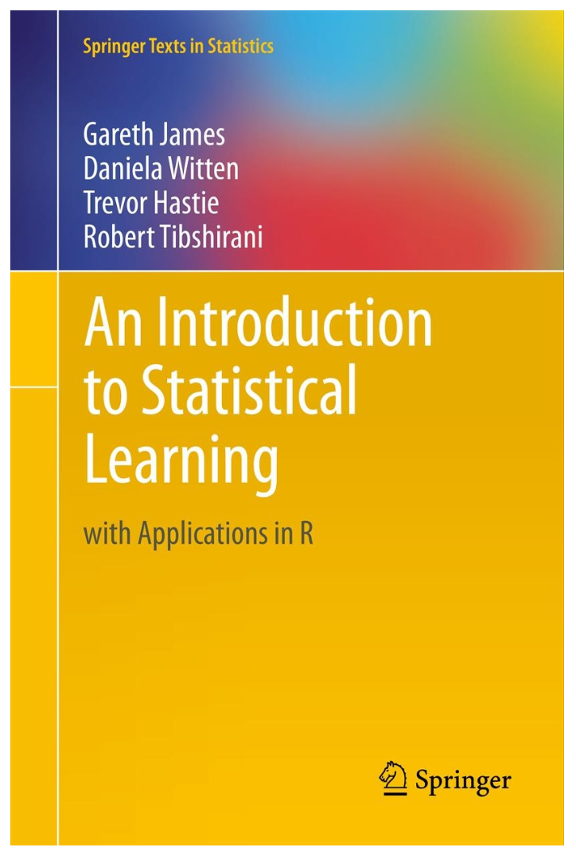
Introduction to Machine Learning
In this unit, we will examine ML from a statistical viewpoint.
Freely available at https://www.statlearning.com/ .
Notes:
Because I am a statistician by practice, we will be looking at ML from a statistical viewpoint. This is main reason I am using this book right here as the textbook for the unit. Plus the book is free, which is ideal for many students.

Slide 5
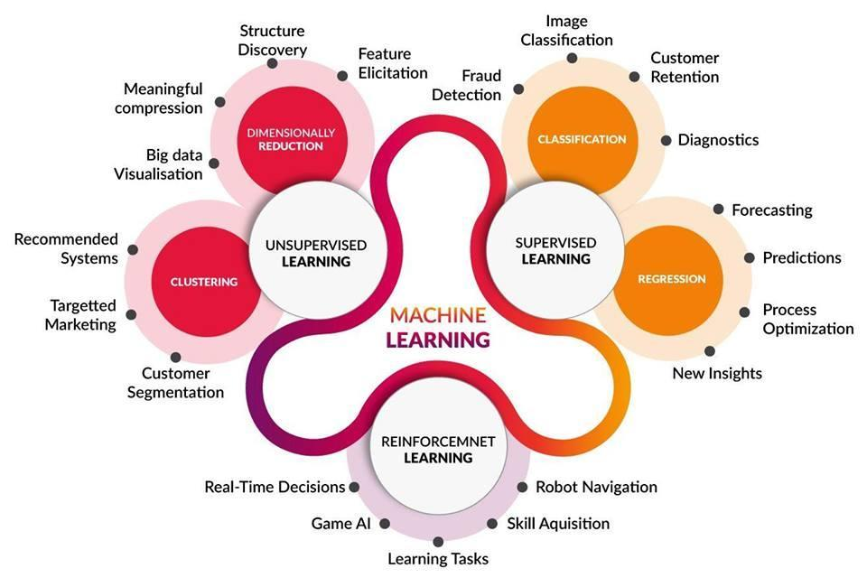
Introduction to Machine Learning
Notes:
In general, ML can be classified into 3 main categories: Supervised, unsupervised and reinforcement learning. In this unit, we will only focus on supervised and unsupervised learning. Supervised learning is a task-driven approach where the goal is to find an optimal way to achieve certain targets. For example, diagnosing whether someone has cancer. Detecting whether an insurance claim is fraudulent, or predicting whether a movie will do well at the box office. On the hand, unsupervised learning is a data driven approach, whereby we’re trying to uncover the underlying pattern or groupings. Unsupervised learning is particular important in marking, for example, in ad targeting, understanding customer behavior and experience.
Reinforcement learning is more about AI, making real-time decisions and learning from mistakes on the fly, which is interesting, but will not be covered in this unit.

Slide 6
Introduction to Machine Learning
Supervised Learning
Infers a function that maps set of inputs (features, predictors, covariates, independent variables) to an output (response, target, outcome, dependent variable) from input/output pairs.
The function is inferred from training examples, which are mapped to new examples.
Goals:
Accurately predict unseen cases, i.e. test cases (primary)
Understand the relationship between inputs and output (secondary)
Two sub-categories:
Regression – a continuous outcome
Classification – a categorical/qualitative outcome
Notes:
In supervised learning, a function is inferred from a set of training examples that then allows us to map a set on inputs to an output. A input is another word for features, predictors, covariates, independent variables and an output is often referred to as a response, target, outcome or dependent variable.
The function itself is optimised within the training examples. Once we have this function, we are then able to mapped to new examples (test cases) and evaluate its performance.
The goals in supervised models are typically to accurately predict unseen cases, and this is generally the primary goal of many ML models. The secondary outcome is to the model to explain the relationship between the input parameters and the output. However, the priority may switch depending on your area.
Within supervised learning there are two broad classes: regression and classification. Regression refers to a situation when we are dealing with a continuous outcome or output and is quantifiable by some values or numbers (predicting how much a person is willing to pay for a product), whereas in classification problems, the outcome is a categorical or qualitative (whether an insurance claim is a fraud, or whether an email is a spam email).

Slide 7
Introduction to Machine Learning
Unsupervised Learning
No distinctions between input(s) and output within a data set.
Attempts to uncover the underlying structure or pattern within a data set.
Can lead to testable hypotheses.
Difficult to know how well you have done.
Two sub-categories:
Dimension reduction – visualisation of multi-dimensional data in lower dimensions, 2-D and 3-D.
Clustering – grouping of objects based on some similarity measures.
Notes:
In unsupervised learning, there is no distinctions between what are your input(s) and what are your output within a data. Here, we’re not trying to infer a function between the inputs and output to make predictions. In unsupervised learning, we don’t have a starting point. We don’t have a hypothesis to direct us as to how to go about modelling the data.
In unsupervised learning, we want to uncover the underlying structure or pattern in the data that we can work with. This also means that unsupervised learning can be
somewhat subjective. One person’s view of a pattern may be different to another, which means that it’s difficult quantify or evaluate how well you done unless the underlying pattern is clear and obvious. If this is the case, then this can lead to the development of hypotheses that we can later test with a statistical model or ML model. Unsupervised learning can be a precursor to supervised learning.
There are two sub-categories of unsupervised learning; dimension reduction and clustering
In dimension reduction, we attempt to map multi-dimensional data to lower dimensions so that we can make sense of it, given that as human beings, we are not able to visualise beyond 3 dimensions. In dimension reduction, we will inevitably lose some information, and this is the trade off if we want to be able to visualise the data.
Clustering refers to an approach that allows us to group objects or individuals based on some measures of similarity or distance. If the groupings are fairly obvious, then we can turn it into a classification problem and building a machine learning model for distinguish the groups.

Slide 8
Introduction to Data Analysis
What is statistics?
Statistics allow us to learn from our data.
Data are numbers with context.
Data contains information about some group of individuals.
A characteristic of an individual is referred to as a variable.
Notes:
Regardless of what area you’re in, statistics will play a prominently role in machine learning.
Statistics is a science that allows us to learn from our data, which is a record of the phenomenon being studied
Data are more than just numbers, but rather, numbers that are placed in context. Data are meaningless without context. This means that for any dataset, you must have the relevant background information to be able to make sense of it and move forward with whatever that you need to do. This includes the unit. For example, if data is Age, then you need to specify if this is in years, or in months. The latter would be applicable if you’re dealing with children.
Data will always contain information about some group of individuals. An individual can be an object, an animal or a person. The characteristics of an individual is referred to as a variable. For example if the individual is a person, a characteristic could be the person’s height, age or nationality.

Slide 9
Introduction to Data Analysis
Data Types
Two main types of data:
Qualitative (categorical) – variables that represent qualities and cannot be measured.
Nominal – characteristics have no order, e.g. eye colour, gender (male/female).
Ordinal – characteristics that are intrinsically ordered, e.g. educational attainment (primary, secondary, tertiary).
Quantitative (numerical)
Discrete – able to take only certain distinct values within an allowable range. The allowable range maybe finite or infinite. For example, outcome of a dice roll, and number of students.
Continuous – data measured on a scale, able to take on any values within an allowable range which maybe finite or infinite, e.g. body mass, height.

Slide 10
Introduction to Data Analysis
Exploratory Data Analysis (EDA)
EDA is the process of describing the data and summarising the main characteristics.
Provides some insight into the behaviour of the data.
A critical aspect of EDA is outlier detection.
Describe graphically and numerically.

Slide 11
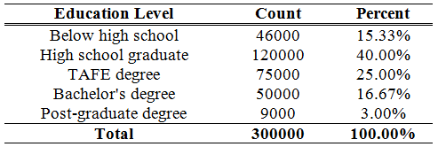
Introduction to Data Analysis
Describing Qualitative and Discrete Data
Qualitative and discrete (finite) data are typically expressed as count data.
For a better perspective, counts are often expressed as a percentage of the total.

Slide 12
Introduction to Data Analysis
Describing Quantitative Data
Three aspects are addressed
Measure of Centre: describes how data cluster around a particular value.
Measure of Spread: describes the dispersion/variability of data
Measure of Shape: describes the distribution (or pattern) of data.

Slide 13
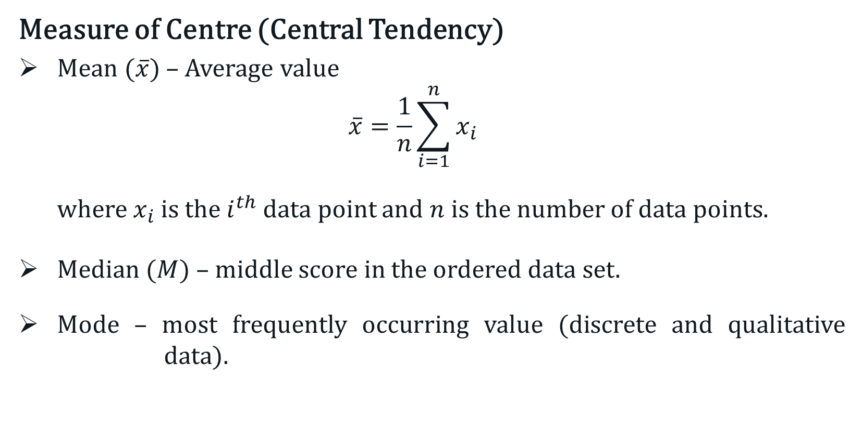
Introduction to Data Analysis
Measure of Centre (Central Tendency)
Mean ($\overline{x}$) – Average value
$$\overline{x}=\frac{1}{n}\sum_{i=1}^{n}{x_{i}}$$
where $x_{i}$ is the $i^{th}$ data point and $n$ is the number of data points.
Median ($M$) – middle score in the ordered data set.
Mode – most frequently occurring value (discrete and qualitative data).

Slide 14
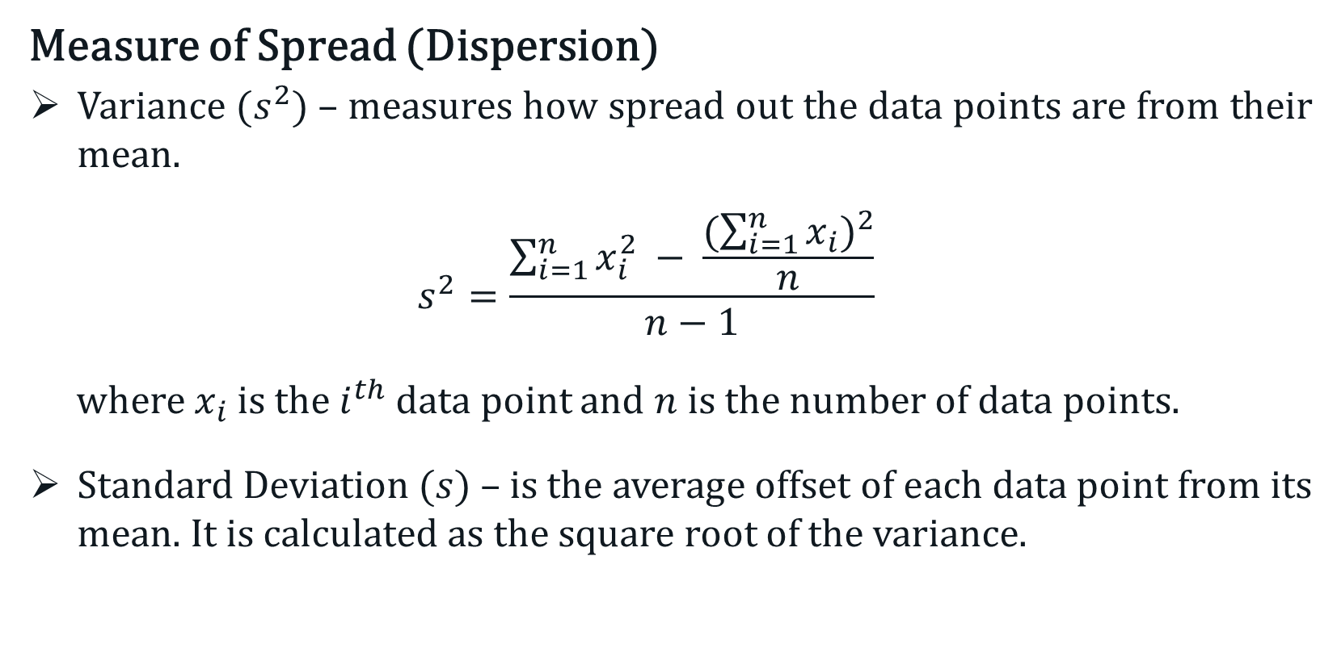
Introduction to Data Analysis
Measure of Spread (Dispersion)
Variance ($s^{2})$– measures how spread out the data points are from their mean.
$$s^{2}=\frac{\sum_{i=1}^{n}{x_{i}^{2}} − \frac{{(\sum_{i=1}^{n}{x_{i}})}^{2}}{n}}{n−1}$$
where $x_{i}$ is the $i^{th}$ data point and $n$ is the number of data points.
Standard Deviation ($s$) – is the average offset of each data point from its mean. It is calculated as the square root of the variance.

Slide 15
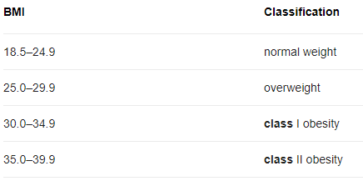

Introduction to Data Analysis
Example :
BMI of 30 subjects
33.6 | 38.3 | 26.9 | 25.2 | 36.4
27.8 | 29.1 | 54.3 | 30.5 | 41.5
40.9 | 47.8 | 28.9 | 27.4 | 29.4
24.5 | 24.5 | 29.1 | 31.4 | 26.5
41.8 | 33.2 | 28.2 | 27.7 | 30.1
44.7 | 47.1 | 42.1 | 33.5 | 37.2

Slide 16
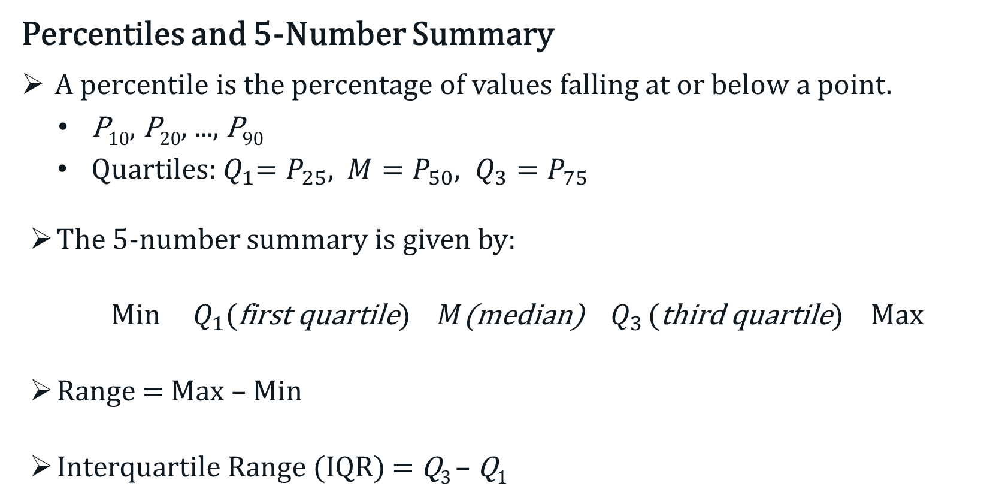
Introduction to Data Analysis
Percentiles and 5-Number Summary
A percentile is the percentage of values falling at or below a point.
P₁₀, P₂₀, ..., P₉₀
Quartiles:${ Q}_{1}=P_{25}$, $M=P_{50}, Q_{3}=P_{75}$
The 5-number summary is given by:
Min $Q_{1}$(first quartile) $M$(median) $Q_{3}$ (third quartile) Max
Range = Max – Min
Interquartile Range (IQR) = Q₃ – Q₁

Slide 17



Introduction to Data Analysis
Example :
BMI of 30 subjects
33.6 | 38.3 | 26.9 | 25.2 | 36.4
27.8 | 29.1 | 54.3 | 30.5 | 41.5
40.9 | 47.8 | 28.9 | 27.4 | 29.4
24.5 | 24.5 | 29.1 | 31.4 | 26.5
41.8 | 33.2 | 28.2 | 27.7 | 30.1
44.7 | 47.1 | 42.1 | 33.5 | 37.2
Min
Median
Max
$$Q_{1}$$
$$Q_{3}$$

Slide 18
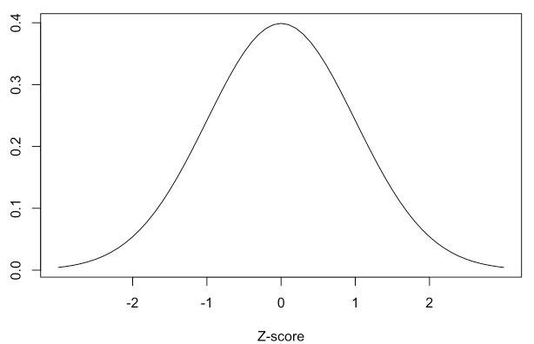
Introduction to Data Analysis
Measure of Shape
Two measures:
Skewness – a measure of symmetry, or more precisely, the lack of symmetry. A distribution is symmetric if it looks the same to the left and right of the centre point.
Kurtosis – is a measure tailed-ness relative to a normal distribution.
Standard Normal Distribution

Slide 19
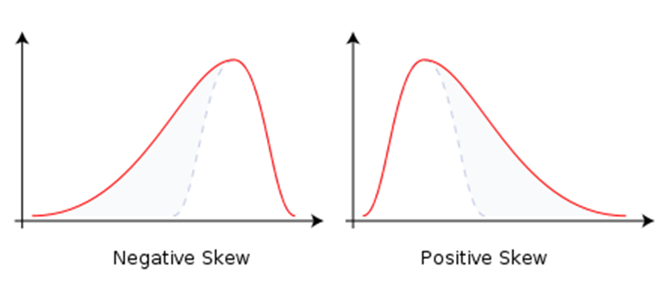
Introduction to Data Analysis
Skewed Distributions
Skewness < 0 Skewness > 0

Slide 20
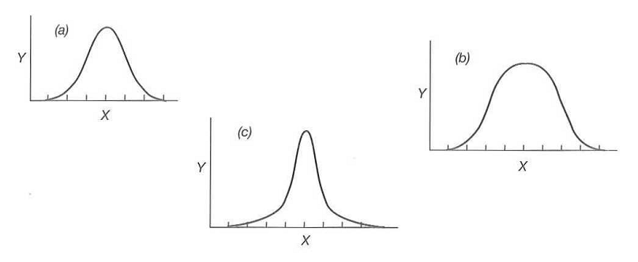
Introduction to Data Analysis
Excess Kurtosis
Leptokurtic
Kurtosis > 3
Mesokurtic
Kurtosis = 3
Platykurtic
Kurtosis < 3

Slide 21
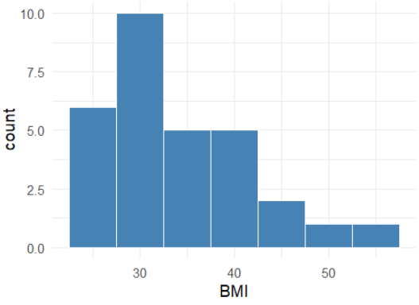

Introduction to Data Analysis
Example :
Histogram
BMI of 30 subjects
33.6 | 38.3 | 26.9 | 25.2 | 36.4
27.8 | 29.1 | 54.3 | 30.5 | 41.5
40.9 | 47.8 | 28.9 | 27.4 | 29.4
24.5 | 24.5 | 29.1 | 31.4 | 26.5
41.8 | 33.2 | 28.2 | 27.7 | 30.1
44.7 | 47.1 | 42.1 | 33.5 | 37.2

Slide 22
Data Quality Issues
What are the issues to consider?
Data entry errors
Values outside of expected range(s)
Missing values
Noted as NA in R
>20% is not good.
Outliers
Certain descriptive statistics and modelling are sensitive to them
Can lead to bias estimates and potentially incorrect findings

Slide 23
Data Quality Issues
Handling Missing Values
Approach 1: Drop any features with missing values
Typically not recommended
Depends on the % of missing values
The is.na(.) command in R can be used to check for missing values
Approach 2: Analyse complete cases only
Use the na.omit(.) command in R
Important to note % of cases removed
Approach 3: Impute the missing values
Mean imputation, regression imputation, K-NN and etc.
Recommended only for continuous data
Notes:
Be aware of the algorithm that you will be applying to the data. Some algorithms can handle missing data.

Slide 24
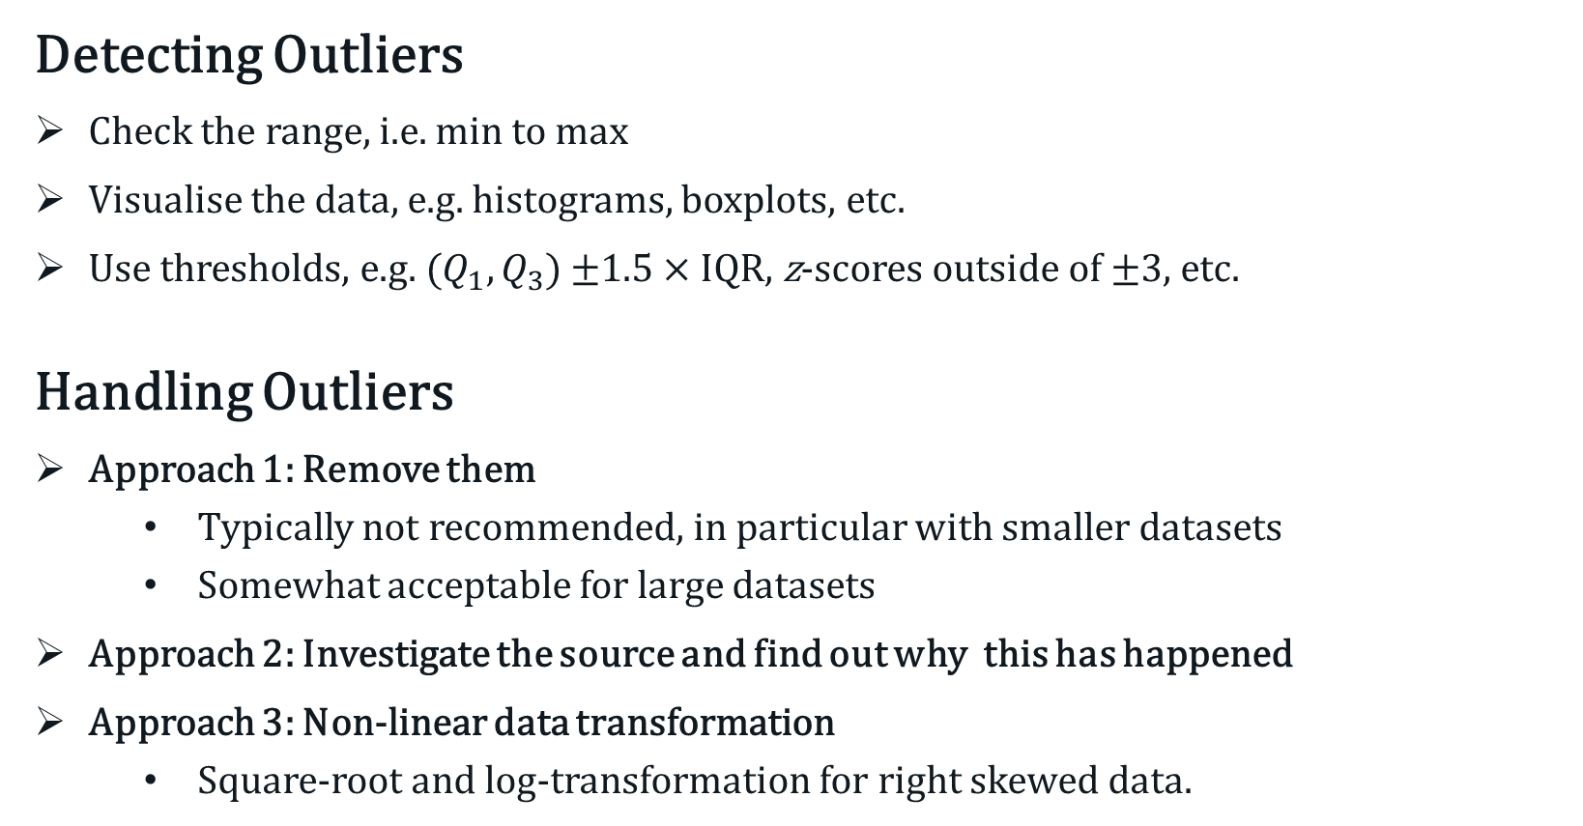
Data Quality Issues
Detecting Outliers
Check the range, i.e. min to max
Visualise the data, e.g. histograms, boxplots, etc.
Use thresholds, e.g. ($Q_{1}, Q_{3}$) ±1.5 × IQR, z-scores outside of ±3, etc.
Handling Outliers
Approach 1: Remove them
Typically not recommended, in particular with smaller datasets
Somewhat acceptable for large datasets
Approach 2: Investigate the source and find out why this has happened
Approach 3: Non-linear data transformation
Square-root and log-transformation for right skewed data.
Notes:
Be aware of the algorithm that you will be applying to the data. Some algorithms can handle missing data.

